Slide 1
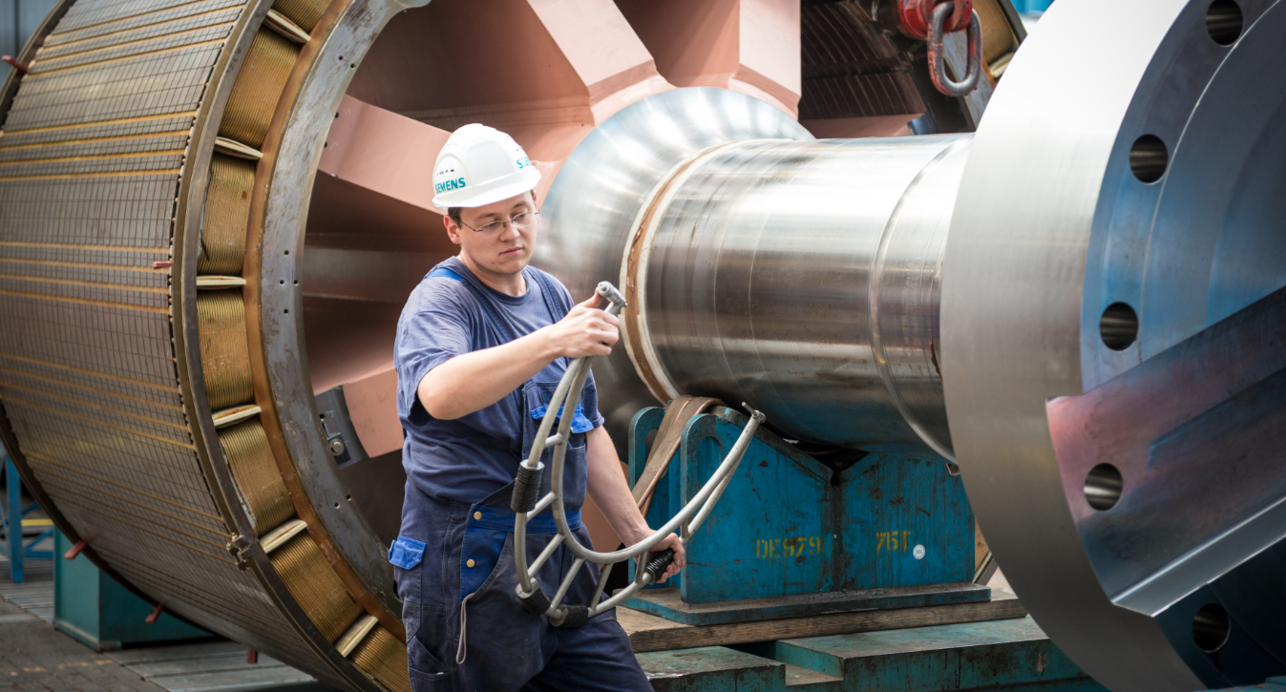
Customer requirements
Ensure the availability of motors, even after many years of service
Minimized unplanned and expensive failures caused by the aging and wear of motors
Extend the lifetime of motors
Tailored service solutions for customer-specific requirements
Tailored service solutions for customer-specific requirements

Slide 2
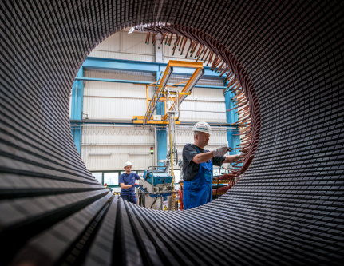
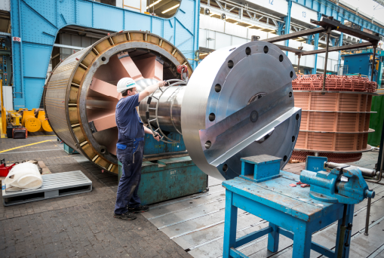
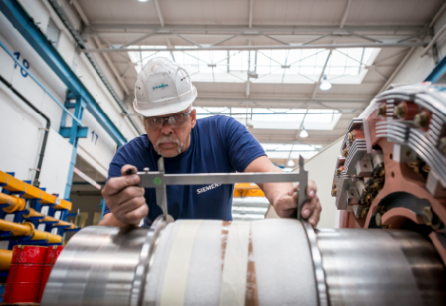
Aging and wear as a challenge
The aging and wear processes affect the availability of a motor
Operational challenges
Possible consequences of aging and wear…
Contamination of the motor – internal and external
Faults or changes in the power network
External, mechanical faults such as torque peaks
Highly stressing operating conditions such as increased load
Insufficient compatibility between production requirements and maintenance measures
… in the winding system:
Faults in the stator winding
… in the rotor system:
Faults on the slip-rings and brushes
… in the bearing system:
Contaminations and oil leakages in the bearing area

Slide 3
Availability even after many years of service
Services for SIMOTICS HV
Objectives
Ensure the long-term availability of motors, even after many years of service
Longer lifetime of motors
Minimization of failures caused by aging and wear
Inclusion of customer requirements, such as planned production utilizations
Solution
Benefits
Detection of the aging and wear processes with a thorough analysis of the motor condition
Creation of a tailored service solution taking account of the customer's special requirements
In-depth analysis of the motor condition by experts gives transparency
Services from a single source matched to the actual condition of an individual motor
Minimization of downtimes during the analysis and implementation phases
Ideally, financing only via OPEX

Slide 4
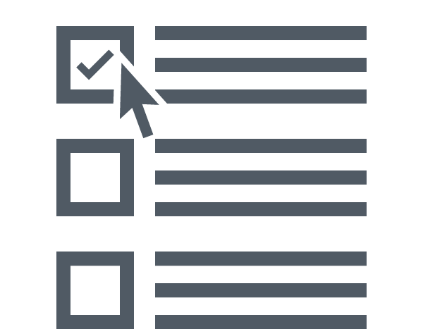
Analysis of the motor condition
Analysis of the motor condition
Tailored service solution
Motor Condition Assessment
Collection of data
Analysis
Report
Service history of the motor
Customer know-how such as:
Load characteristic
Fault incidents
Maintenance history
Motor inspection
Performed by Siemens experts:
Mechanical tests
Electrical measurements
Experts in relevant areas
Service engineering for motors
Development
Manufacturing technology
Motor Condition Report
Quantification of wear
Forecast of remaining lifetime
Repair and replacement recommendations
CHECK
Results of the Motor Condition Report and special customer requirements, such as planned production utilizations, as basis for the composition of the individual service solution

Slide 5
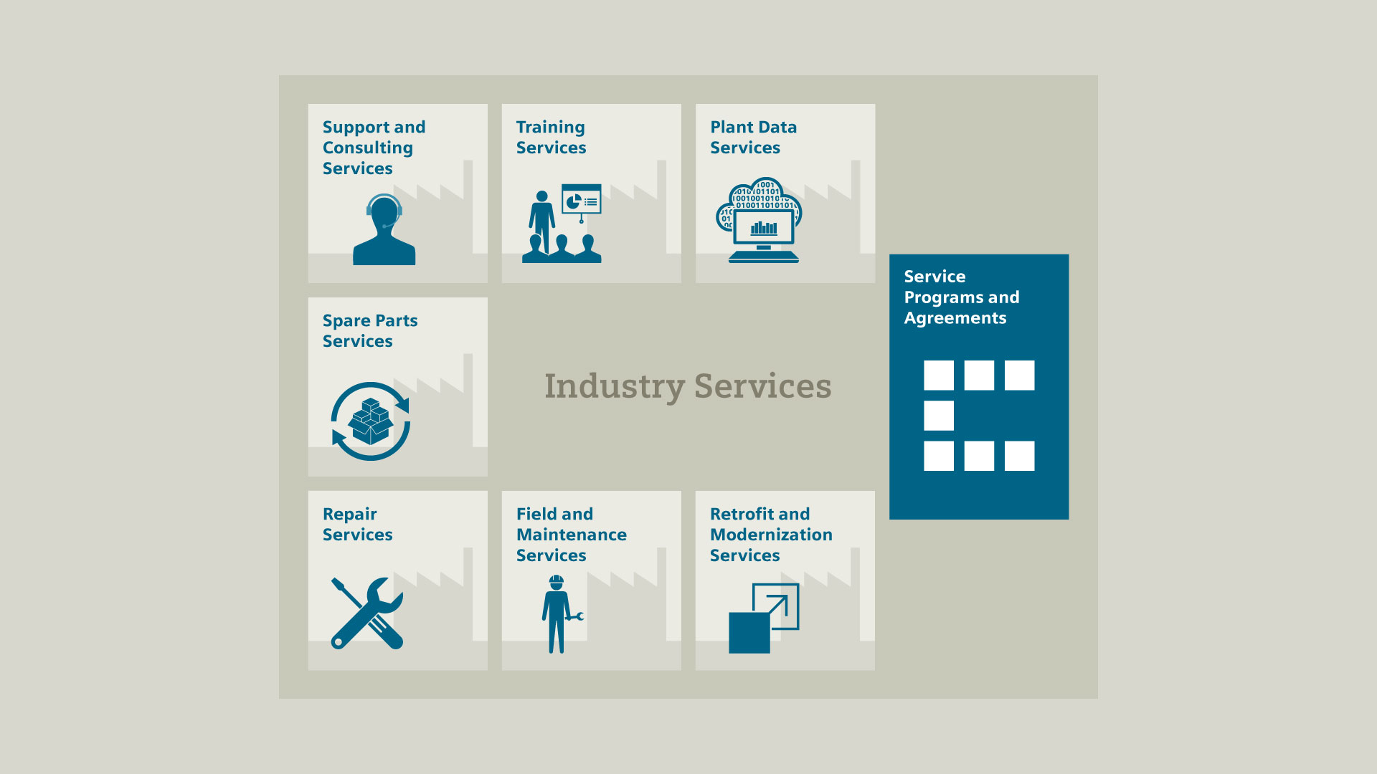
Tailored service solution
Analysis of the motor condition
Tailored service solution
Service portfolio

Slide 6
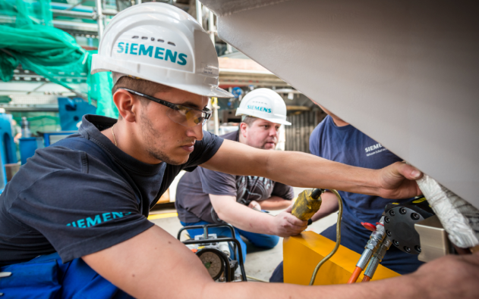
Tailored service solution
Analysis of the motor condition
Tailored service solution
Service portfolio (1+2)
Field and Maintenance Services
Availability of motors ensured with preventive maintenance measures
Optional integration in a long-term service program:
Repair Services
General overhaul in a certified service workshop or at the Siemens factory in Berlin
Including specific repairs and possibly replacement (partial retrofit)
Minimization of failures by the replacement of parts subject to wear and aging

Slide 7
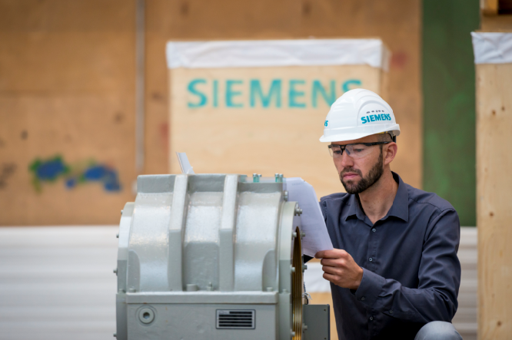
Tailored service solution
Analysis of the motor condition
Tailored service solution
Service portfolio (3)
Spare Parts Services
Option 1: Spare Parts Packages
Provision of optimized product or plant-specific Spare Parts Packages
Spare parts do not need to be ordered when fault incidents occur, but are available in the customer site warehouse
Option 2: Spare Parts Concepts
Inventory and quality controls of the spare parts already available in customer site warehouse
Estimate of the expected requirements considering the lifetime and condition of the motor
Development of an individual Spare Parts Concept together with the customer

Slide 8
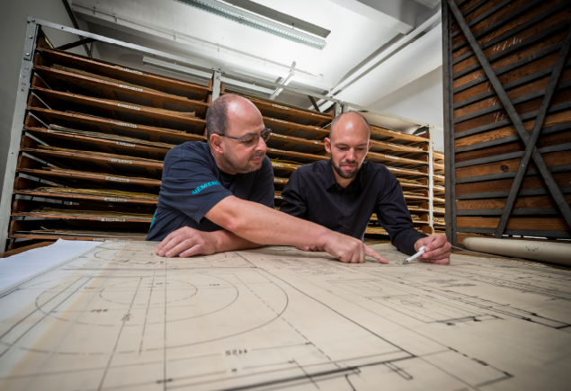
Tailored service solution
Analysis of the motor condition
Tailored service solution
Service portfolio (4)
Retrofit Services
Option 1: Duplicating the motor 1:1
Original parts are replaced with an identical new part
Proven drive train solutions remain essentially unchanged
Only brief interruption of production during replacement
Option 2: Upgrade to the latest technology
Functional replacement of the old motor with a new machine from the current Siemens product range
Not only a complete motor retrofit (replacement of the motor), but also a partial retrofit (replacement of individual components, such as the stator or the rotor) is possible
The current specifications and regulations are taken into account and long-term operating cost reductions achieved

Slide 9
Example retrofit
Retrofit
Initial situation
Compressor driven by a 12 MW motor (date of manufacture 1987)
Application in an explosion-protected area
The Motor Condition Assessment indicated significant winding aging
Customer request with regard to duplicating the motor 1:1 that meets the explosion protection regulations
Solution
Customer benefits
Duplicating the motor 1:1 is very expensive and its application in an explosion protected area is not possible
Profitability analysis by Siemens: Duplicating the motor 1:1 compared with an upgrade to the latest technology
Lowest-cost solution: Retrofit with upgrade to latest technology (adapted shaft height, adaptations of the plant)
Support during the coordination with the responsible authorities for explosion protection
Solution with the maximum economic benefits as a result of the analysis of various alternatives
Replacement of the old motor and upgrade to state-of-the-art technology
Minimized downtimes during the analysis and implementation phase
Conformance with the latest explosion protection regulations

Slide 10
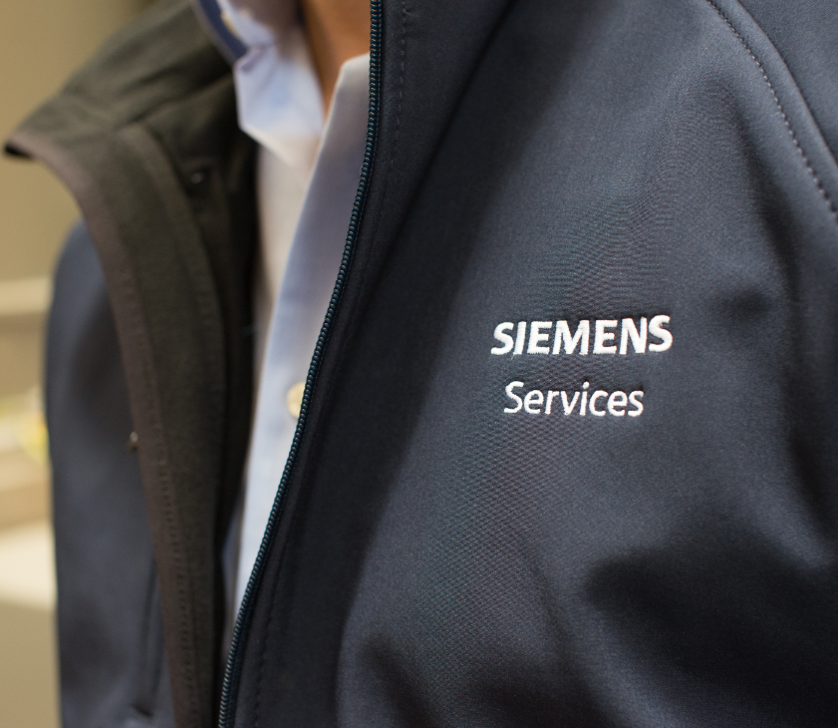
Why Siemens?
Siemens has a global sales and service network in order to be near as possible to the customer
Long-term experience and comprehensive know-how ensures development customer-specific solutions while providing maximum reliability and quality
A comprehensive service portfolio ensures tailored service solutions adapted to the special requirements of the customer, including:
Individual maintenance schedule
Product-specific Spare Parts Packages
Retrofit
Tailored, efficient financing solutions increase a customer’s financial scope and ensure long-term competitiveness

Slide 11
Achieve your objective together with Siemens as your partner
Guaranteed availability of motors, even after many years of service
Minimized unplanned and expensive failures caused by the aging and wear of motors
Longer lifetime of motors
Tailored service solution for customer-specific requirements

